Slide 1
COMP315 – Advanced Programming
OpenGL: Viewing
Deshen Moodley
2014

Slide 2
Computer Viewing
There are three aspects of the viewing process, all of which are implemented in the pipeline,
Positioning the camera
Setting the model-view matrix
Selecting a lens
Setting the projection matrix
Clipping
Setting the view volume

Slide 3
Perspective vs Parallel projection
Computer graphics treats all projections the same and implements them with a single pipeline
Classical viewing developed different techniques for drawing each type of projection
Fundamental distinction is between parallel and perspective viewing even though mathematically parallel viewing is the limit of perspective viewing

Slide 4
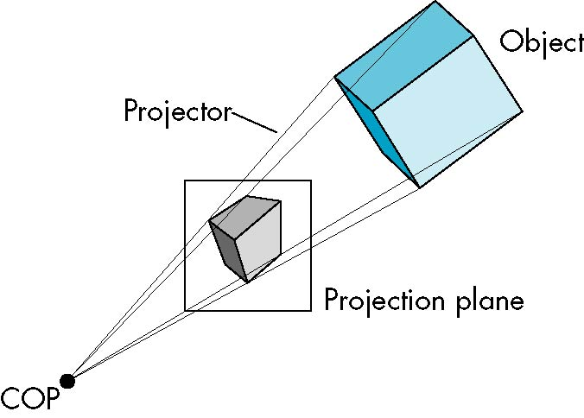
Perspective Projection

Slide 5
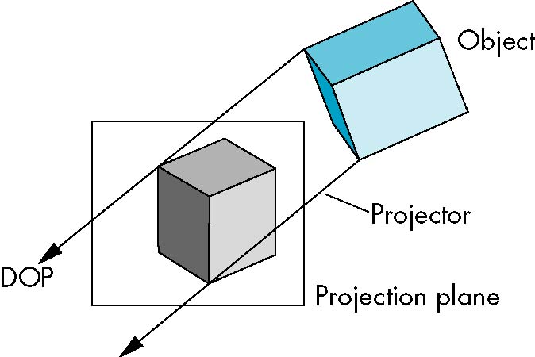
Parallel Projection

Slide 6
The OpenGL Camera
In OpenGL, initially the object and camera frames are the same
Default model-view matrix is an identity
The camera is located at the origin and points in the negative z direction
OpenGL also specifies a default view volume that is a cube with sides of length 2 centered at the origin
Default projection matrix is an identity

Slide 7
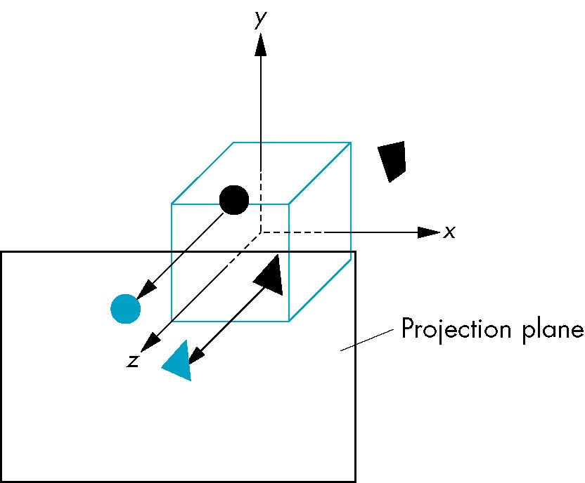
Default Projection
Default projection is orthogonal
clipped out
2
z=0

Slide 8
The LookAt Function
The GLU library contains the function glu.gluLookAt() to form the required modelview matrix through a simple interface
Note the need for setting an up direction (vector)
gluLookat(
eyex,eyey,eyez,
atx, aty, atz,
upx,upy,upz
)

Slide 9
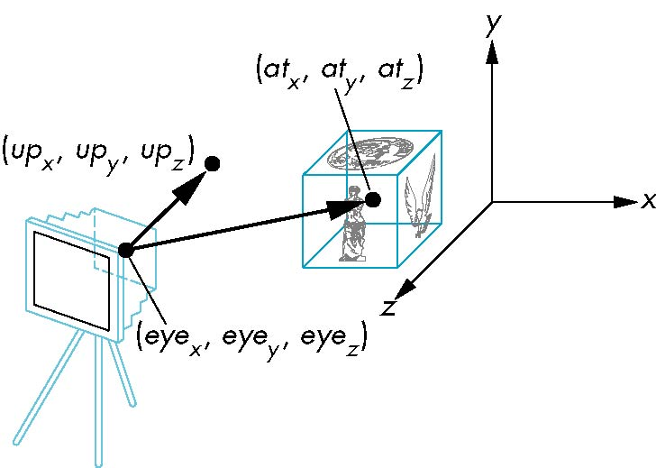
gluLookAt
gluLookAt(eye, at, up)

Slide 10
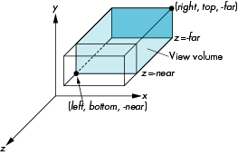
OpenGL Orthogonal Viewing
gl.glOrtho(left,right,bottom,top,near,far)
near and far measured from camera

Slide 11
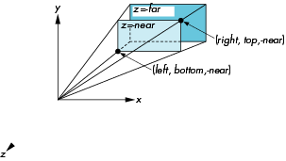
OpenGL Perspective
Frustum(left,right,bottom,top,near,far)

Slide 12
Using Field of View
gluPerpective(fovy, aspect, near, far) often provides a better interface

Slide 13
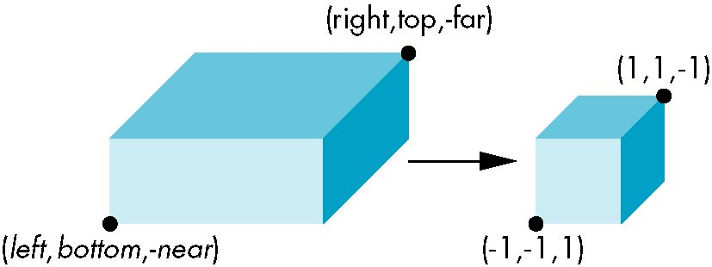
Orthogonal Normalization
Ortho(left,right,bottom,top,near,far)
normalization ⇒ find transformation to convert
specified clipping volume to default

Slide 14
Additional material – for information only

Slide 15
Projections and Normalization
The default projection in the eye (camera) frame is orthogonal
For points within the default view volume
Most graphics systems use view normalization
All other views are converted to the default view by transformations that determine the projection matrix
Allows use of the same pipeline for all views
x_{p} = x
y_{p} = y
z_{p} = 0

Slide 16
Homogeneous Coordinate Representation
default orthographic projection
x_{p} = x
y_{p} = y
z_{p} = 0
w_{p} = 1
p_{p} = Mp
M =
In practice, we can let M = I and set
the z term to zero later

Slide 17
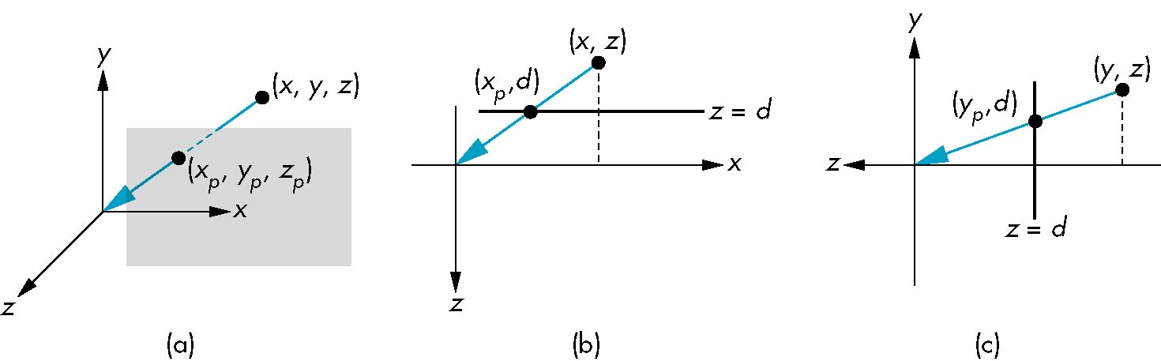
Simple Perspective
Center of projection at the origin
Projection plane z = d, d < 0

Slide 18
Perspective Equations
Consider top and side views
x_{p} =
y_{p} =
z_{p} = d

Slide 19
Homogeneous Coordinate Form
consider q = Mp where
M =
q =
⇒ p =

Slide 20
Perspective Division
However w ≠ 1, so we must divide by w to return from homogeneous coordinates
This perspective division yields
the desired perspective equations
We will consider the corresponding clipping volume with mat.h functions that are equivalent to deprecated OpenGL functions
x_{p} =
y_{p} =
z_{p} = d

